Slide 1

EMOTION DETECTION FROM SPEECH
PRESENTED BY
DADRAHEEM, ALI RAZA AND GUARAM

Slide 2


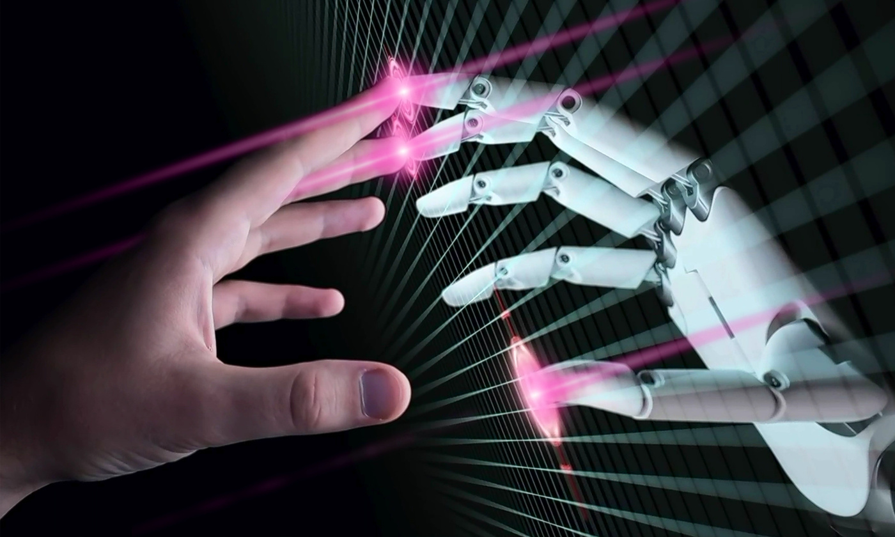
INTRODUCTION
Emotion detection = identifying human emotions from speech signals.
Important for AI, call centers, healthcare, virtual assistants.
Key emotions: Happy, Sad, Angry, Neutral, Fear, Surprise, Disgust.

Slide 3
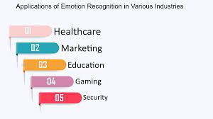
APPLICATIONS
1
Customer service & call center analysis
1
Mental health monitoring
1
Human-computer interaction (HCI)
1
Smart assistants & chatbots

Slide 4
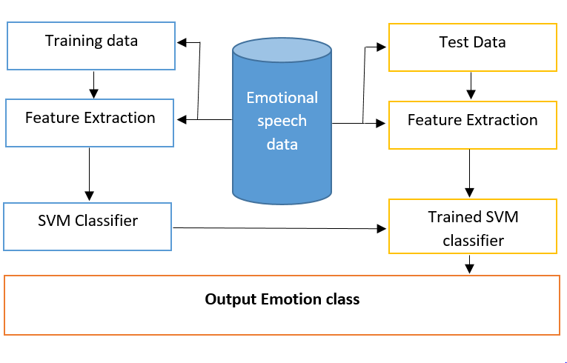
SPEECH EMOTION FEATURES
1. Acoustic Features
Pitch (frequency of voice)
Energy (loudness)
Tempo (speech rate)
2. Spectral Features
MFCCs (Mel Frequency Cepstral
Coefficients)
Formants (resonant frequencies)
Chroma features
3. Prosodic Features
Intonation, rhythm, stress

Slide 5
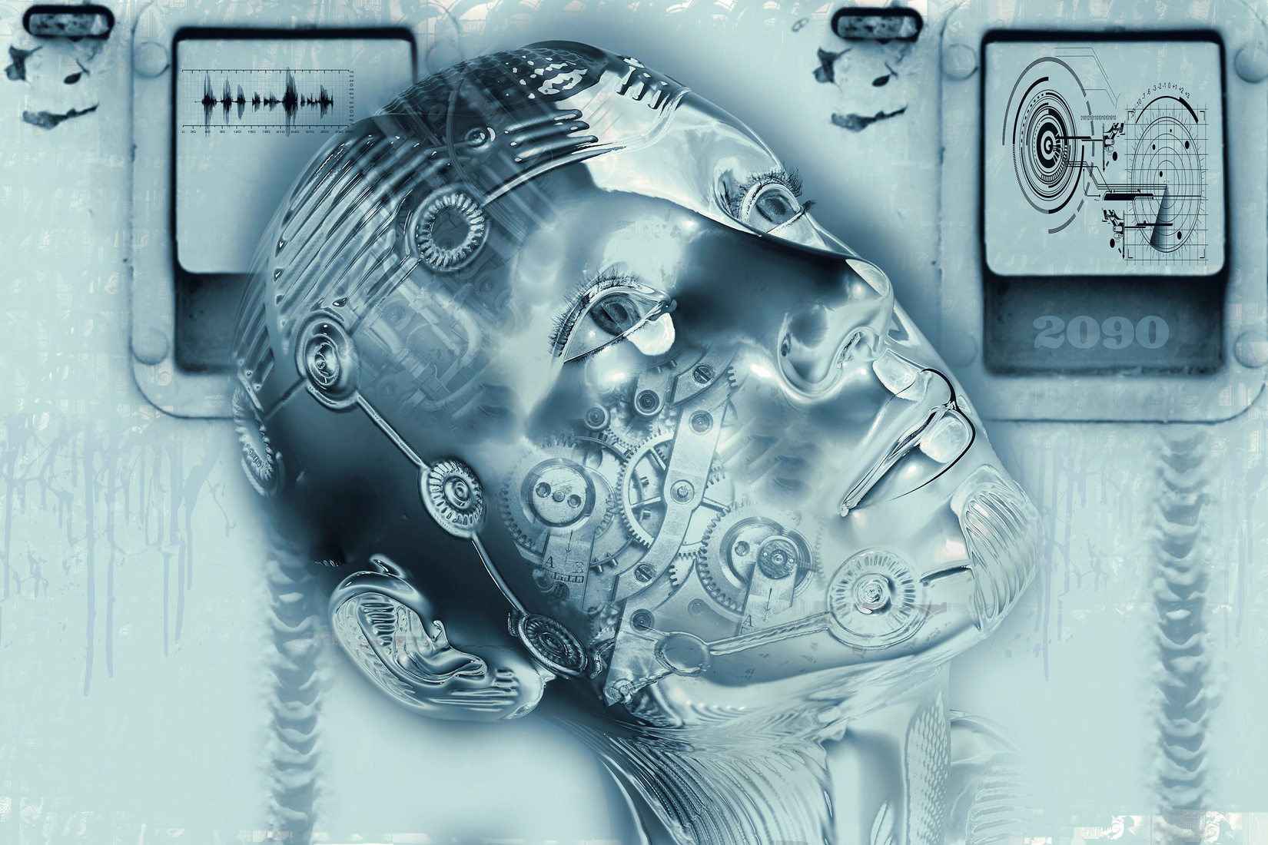
MACHINE LEARNING MODELS
Traditional ML:
SVM (Support Vector Machine)
Random Forest
KNN (K-Nearest Neighbors)
Deep Learning:
CNN (Convolutional Neural Network)
RNN / LSTM (Recurrent Neural
Network / Long Short-Term Memory)
Transformers for speech

Slide 6

DATASETS
RAVDESS: 24 actors, 8 emotions
EMO-DB: German emotional speech database
TESS: Toronto Emotional Speech Set
IEMOCAP: Multimodal, 5 emotions

Slide 7


CHALLENGES
EMOTION IS SUBJECTIVE
Accents, languages, speech speed variations
Background noise
Limited labeled datasets
CONCLUSION
SPEECH EMOTION DETECTION ENHANces HCI and AI applications.
Key is feature extraction + accurate classification.
Deep learning methods show promising results.

Slide 8

THANK YOU!

